Slide 1
“Calculus Concepts and Applications in Engineering”

Slide 2
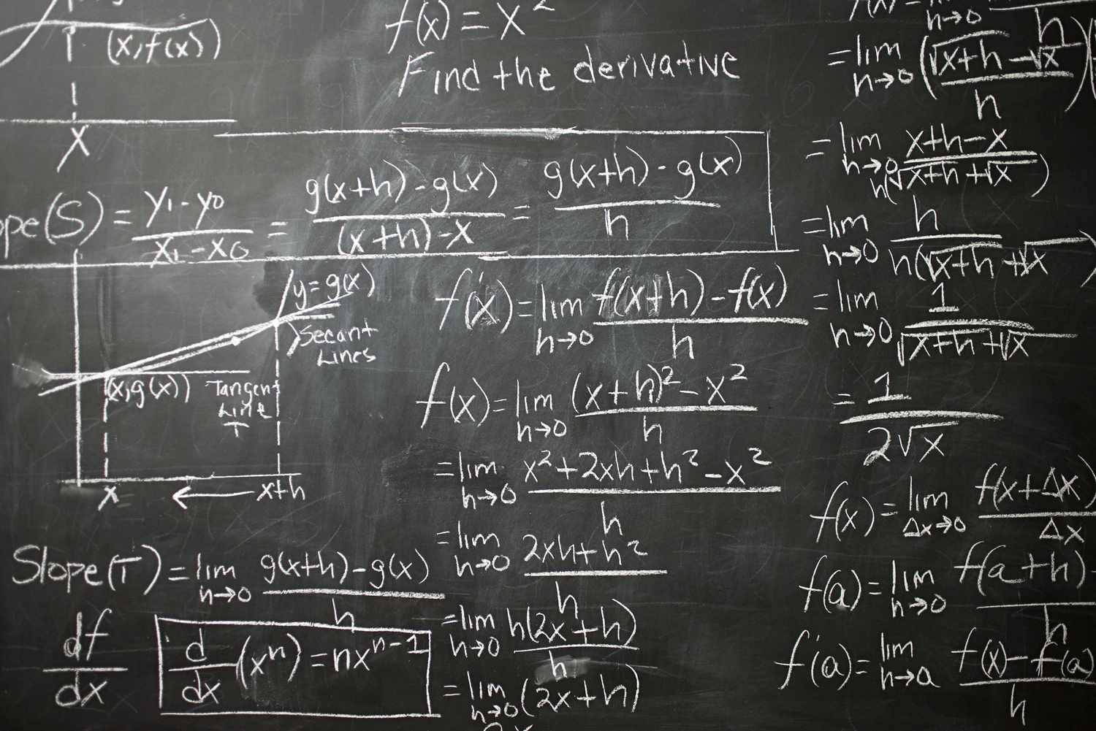
What is Calculus?
Calculus is the mathematics of change and motion. It has two main branches: 1. Differentiation – Measures how fast something is changing (like speed). 2. Integration – Measures the total amount (like area or total distance).

Slide 3
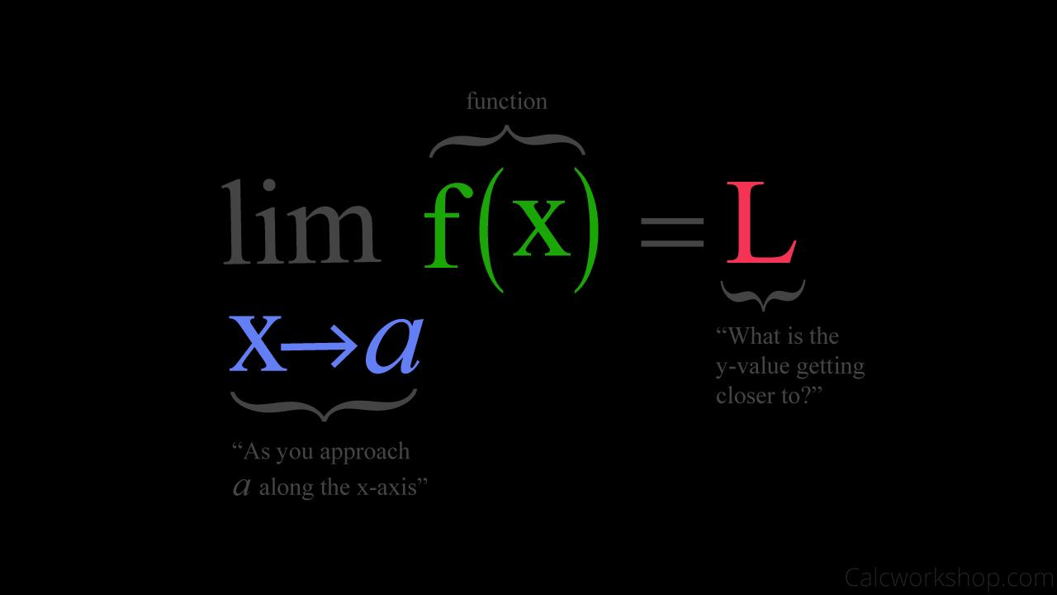
Limits
A limit tells us how a function behaves as it gets close to a certain point. Example: \lim_{x \to 0} \frac{\sin(x)}{x} = 1

Slide 4

Derivatives
A derivative is the rate of change of a function. Example: \frac{d}{dx}(x^2) = 2x

Slide 5
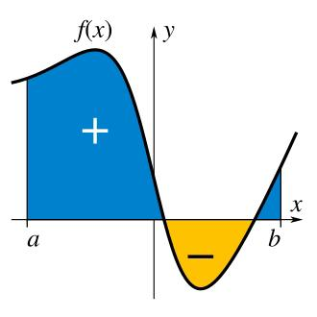
Integrals
Integration calculates the area under a curve. Example: \int x \, dx = \frac{1}{2}x^2 + C

Slide 6
Fundamental Theorem of Calculus
This theorem connects integration and differentiation. If F(x) is the antiderivative of f(x), then: \int_a^b f(x) \, dx = F(b) – F(a)

Slide 7
Multivariate Gradients
When a function has more than one variable, the gradient shows the direction of steepest increase. Example: \nabla f(x, y) = \left[\frac{\partial f}{\partial x}, \frac{\partial f}{\partial y}\right]

Slide 8
Numerical Differentiation (with NumPy)
If you don’t have an exact formula, you can use finite difference to estimate derivatives.
Code Example:
Import numpy as np f = lambda x: x**2 h = 1e-5 gradient = (f(1 + h) – f(1)) / h

Slide 9
Numerical Integration (with NumPy)
To estimate area under a curve, use the trapezoidal rule.
Code Example: import numpy as np x = np.linspace(0, 1, 100) y = x**2 area = np.trapz(y, x)

Slide 10
Summary
Limits show function behavior Derivatives describe change Integrals give total area/accumulation NumPy helps with real-world numerical methods in engineering

